Slide 1
Purim: Celebrating Jewish Deliverance and Joy
Exploring the traditions and significance of Purim
© 2025 Georgia Chaplain Services LLC All rights reserved
Notes:
---
Purim is a festive Jewish holiday that celebrates the deliverance of the Jewish people from a plot to destroy them, as outlined in the Book of Esther. This presentation will explore the historical background, traditional customs, symbolic foods, the spirit of joy, and how Purim is celebrated around the world.

Slide 2
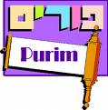



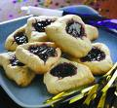

Happy Purim
פורים
Barukh...she'Asah Nissim la'Avoteinu baYamim haHeim baZ'man haZeh (Who performed miracles for our ancestors in those days at this time [of year]).
Reading Megillah
“Revealing”
Book of Esther
Boo Haman and Cheer Mordecai
Eating Hamentashen
Haman’s Hat,
Fruit Cakes
Decorations, Masks and Costumes

Slide 3
Agenda Items
Biblical & Historical Background of Purim
Traditional Observances and Customs
Symbolic Foods and Treats
The Spirit of Joy and Festivity
Purim Around the World
© 2025 Georgia Chaplain Services LLC All rights reserved
Notes:
We will begin with the historical background of Purim, focusing on the story of Esther and Haman and the context of the Persian Empire. Next, we will discuss traditional observances and customs associated with Purim. Then, we will delve into the symbolic foods and treats enjoyed during this holiday. After that, we will explore the spirit of joy and festivity that characterizes Purim celebrations. Finally, we will look at how Purim is observed around the world.

Slide 4
Biblical & Historic Significance of Purim
Notes:
The history of Purim is rooted in the story of Esther, a Jewish queen of Persia, who bravely intervened to save her people from destruction. This backdrop provides essential insights into the significance of the holiday.

Slide 5
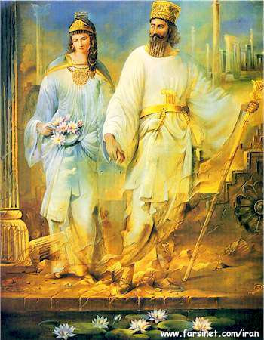
The Book of Esther is written almost like a Fairy Tale with good and evil characters,
sinister plots, ironic twists and happy ending.
Its all about the Kingdom of God!
Key Characters of Purim
King Xerxes / Ahasuerus
Queen Vashti
Haman- The Amalekite
Hegai.
Mordecai, The Benjamite
(Hadassah) Esther
Background Characters
God, Adam, Eve and Satan
Saul (Paul) the Benjamite
The Patriarchs
King Agag the Amalekite
King Saul and David
King Nebuchadnezzar, Cyrus
and Darius
Daniel, Shadrach, Meshach and Abednego
Constantine (Church) and Hitler
Those who obey and honor God will be honored by God!

Slide 6
Who will you Honor & which
Kingdom, will you serve!
Why have you been raised for such a time as this?
Lessons of Purim:
Divine Intervention- The unseen, un-commanded movement of God in History- through the Holy Spirit.
God will establish His Eternal Kingdom through the Jewish Messiah, Israel and Abraham’s Seed by Faith.
God will not allow Satan to destroy Israel (Jewish people).” Those who bless you will be blessed those who curse you will be cursed.
The Appointed Times (Feasts) witness Messiah’s Kingship to the World.
The Kingdom of God is the eternal spiritual home where Believers will live with God in infinite blessing, provision, love, joy, intimacy & holiness as his children.

Slide 7
God has commanded us to destroy sin in our lives. When we don’t we leave a stronghold that will fester.
1 Samuel 15:7-17:50, “Although you (King Saul) were once small in your own eyes, did you not become the head of the tribes of Israel?..
Lord to Saul, ‘Go and completely destroy those wicked people, ..Why did you not obey the Lord?
1 Samuel 15:28-29 Samuel said to him, “The LORD has torn the kingdom of Israel from you today
1 Chronicles 10:12-11:1 Saul died because he was unfaithful to the LORD; he did not keep the word of the LORD
Do we have a stronghold of sin that may hurt us in the future?

Slide 8
God has commanded us to destroy sin in our lives. When we don’t we leave a stronghold that will fester.
1 Samuel 15:7-17:50, “Although you (King Saul) were once small in your own eyes, did you not become the head of the tribes of Israel?..
Lord to Saul, ‘Go and completely destroy those wicked people, ..Why did you not obey the Lord?
1 Samuel 15:28-29 Samuel said to him, “The LORD has torn the kingdom of Israel from you today
1 Chronicles 10:12-11:1 Saul died because he was unfaithful to the LORD; he did not keep the word of the LORD
Do we have a stronghold of sin that may hurt us in the future?

Slide 9
A Major Theme of Purim:
God raises Kings and Kingdoms for His Glory and Purposes
Daniel 2:38-41 To King Nebuchadnezzar, Wherever they live, he has made you ruler over them all.
Daniel 3:12 But there are some Jews whom you have set over the affairs ..They neither serve your gods nor worship the image of gold you have set up.”
Daniel 2:44-45“ … God of heaven will set up a kingdom that will never be destroyed, nor will it be left to another people
Isaiah 45:12-13 I will raise up Cyrus (Persian Empire Replaces Babylonian) in my righteousness: .. He will rebuild my city and set my exiles free, but not for a price or reward, says the LORD Almighty.”
Do we have a stronghold of sin that may hurt us in the future?

Slide 10
A Major Theme of Purim:
Our obedience or disobedience
to God has consequences!
Esther 2:4-7 Now there was in the citadel of Susa a Jew of the tribe of Benjamin, (King Saul’s and Rabbi Saul’s Tribe) named Mordecai son of Jair, the son of Shimei, the son of Kish, who had been carried into exile from Jerusalem by Nebuchadnezzar king of Babylon, (Time of Daniel) among those taken captive with Jehoiachin ª king of Judah.
Esther ..two of the king’s officers who guarded the doorway, became angry and conspired to assassinate King Xerxes. But Mordecai found out about the plot and told Queen Esther, who in turn reported it to the king, giving credit to Mordecai. (Joseph, Daniel)
God raises Mordecai just as he did Joseph!

Slide 11
Satan will tempt us to honor people for prideful reasons versus their character and trust in the Lord!
Esther 1:3-5 and in the third year of his reign he, (Xerxes) gave a banquet for all his nobles and officials. For a full 180 days he displayed the vast wealth of his kingdom and the splendor and glory of his majesty
Esther 3:1-2 After these events, King Xerxes honored Haman son of Hammedatha, the Agagite, elevating him and giving him a seat of honor higher than that of all the other nobles.
All the royal officials at the king’s gate knelt down and paid honor to Haman, …. But Mordecai (Daniel, Shadrach, Meshach and Abednego) would not kneel down or pay him honor.
Pride opens the door to sin!
Do we ever honor the wrong people?

Slide 12
A Major Theme of Purim:
Biblical Holidays and Feasts mark great victories of the Kingdom of God over Satan!
Esther 9:26-28 Therefore these days were called Purim, from the word pur (Lot). the Jews took it upon themselves to establish the custom that they and their descendants and all who join them ..at the time appointed. ..Purim should never cease to be celebrated
Esther 8:17-9:1 In every province and in every city, wherever the edict of the king went, there was joy and gladness among the Jews, with feasting and celebrating. And many people of other nationalities became Jews because fear of the Jews (God of Israel) had seized them.
The Appointed Times are to witness God’s desire, plan and power to redeem his children into the Kingdom of God .

Slide 13


The events of Purim were prophetic to
current end-time events and our recent past.
Hitler was the Hamonic or Anti-Messiah Spirit and we should have recognized this and stopped him before WWII
The Final Solution to the Jewish Question : Die Endlösung der Judenfrage) refers to the German Nazis' plan to engage in systematic genocide against the European Jewish population during World War
God’s plan of redemption is faithful: Israel’s Birth on May 14th 1948.
Israel has fought 8 or more wars, since the day of their inception, including years of terrorism. But they have survived.

Slide 14
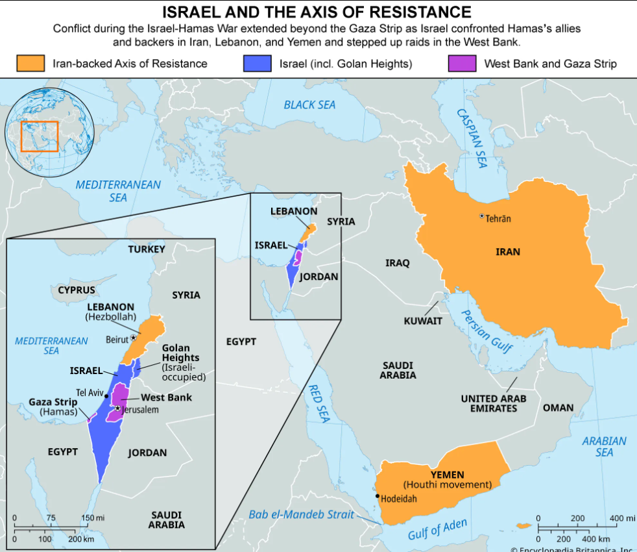
On October 7, 2023
https://www.britannica.com/event/Israel-Hamas-War

Slide 15
On October 7, 2023
History Repeating
Hamas and several other Palestinian militant groups launched coordinated armed incursions from the Gaza Strip into southern Israel.
This marked the first invasion of Israeli territory since the 1948 Arab–Israeli War.
The attacks began with a barrage of at least 4,300 rockets
Hamas militants breached the Gaza–Israel barrier, attacking military bases and massacring civilians in 21 communities,
According to an IDF report, approximately 6,000 Gazans breached the border in 119 locations into Israel,
People killed in Israel on Oct. 7, 2023: Around 1,200
Hostages taken into Gaza: 251
Hostages remaining in Gaza: 73, including 3 taken before Oct. 7, 2023
Hostages in Gaza believed to be dead: 36, including one from before Oct. 7, 2023
Palestinians killed in Gaza: Over 48,200
https://www.britannica.com/event/Israel-Hamas-War

Slide 16
On October 7, 2023
History Repeating
This year, when we praised God for our salvation in ancient Persia, we added a prayer for our own salvation. We did celebrate this year, but our merriment was peppered with discussion of the war, of the state of our nation, of our fears.
But we remembered the Purim story, and as we celebrated, we were able to feel hope. We were able to look ahead and see the light that awaits us even in the midst of the darkness. We celebrated Purim as an act of faith
Arab-Israeli wars, Military conflicts fought between various Arab countries and Israel in 1948–49, 1956, 1967, 1973, 1982, and 2006.
https://cfoic.com/purim-during-war/

Slide 17
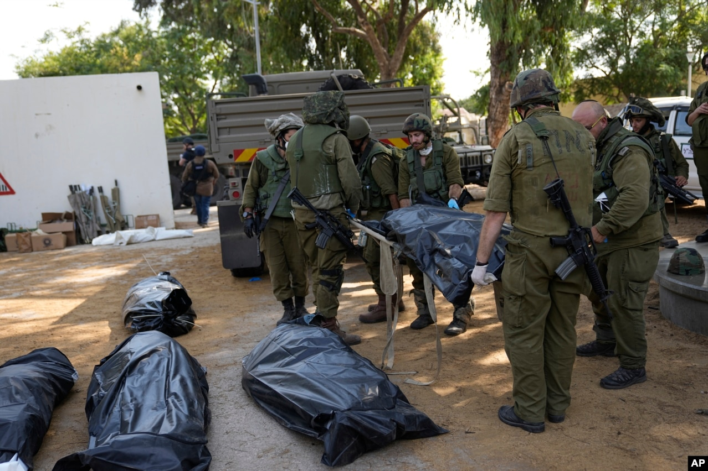
On October 7, 2023
https://www.britannica.com/event/Israel-Hamas-War

Slide 18
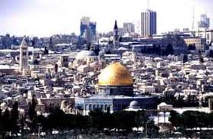
2 Thessalonians 2:3-4 He will oppose and will exalt himself over everything that is called God or is worshiped, so that he sets himself up in God’s temple, proclaiming himself to be God.
Zechariah 14:15-18 Then the survivors from all the nations that have attacked Jerusalem will go up year after year to worship the King, the LORD Almighty, and to celebrate the Feast of Tabernacles. The LORD will bring on them the plague he inflicts on the nations that do not go up to celebrate the Feast of Tabernacles.
Purim was a prophetic warning and blessing!
How to overcome Satan and enter God’s Kingdom!

Slide 19
The Persian Empire Context
Life for Jews in Exile
The Persian Empire presents a complex environment for Jews living in exile, highlighting their struggles and resilience.
Socio-Political Landscape
Understanding the socio-political dynamics of the Persian Empire helps contextualize the events of Purim and its significance.
Cultural Interactions
The Persian Empire fostered diverse cultural interactions, influencing the identity and practices of Jews in exile.
Notes:
The events of Purim take place within the Persian Empire, showcasing the complexities of life for Jews in exile. Understanding the socio-political landscape of the empire is vital to grasping the significance of this story.

Slide 20
The Miraculous Deliverance of the Jews
Miraculous Deliverance
The event of the Jews' deliverance from Haman's decree is considered miraculous, representing hope and resilience.
Significance of Purim
Purim symbolizes the importance of standing up against oppression and injustice in society.
Cultural Remembrance
The story encourages reflection on the struggles against oppression and the triumph of good over evil.
Notes:
The deliverance of the Jews from Haman's decree is viewed as a miraculous event, symbolizing hope and resilience. Purim serves as a reminder of the importance of standing up against oppression.

Slide 21
Traditional Observances and Customs
Some customs and traditions associated with Purim include:
Reading the Megillah
Eating Hamantaschen
Booing Haman and cheering Mordecai
Wearing costumes and masks
Giving gifts and charity (Mishloach Manot and Matanot LaEvyonim)
Festive meals and celebrations
Notes:
Purim is celebrated with various traditional observances and customs that emphasize community, generosity, and joy. These practices have been passed down through generations.

Slide 22
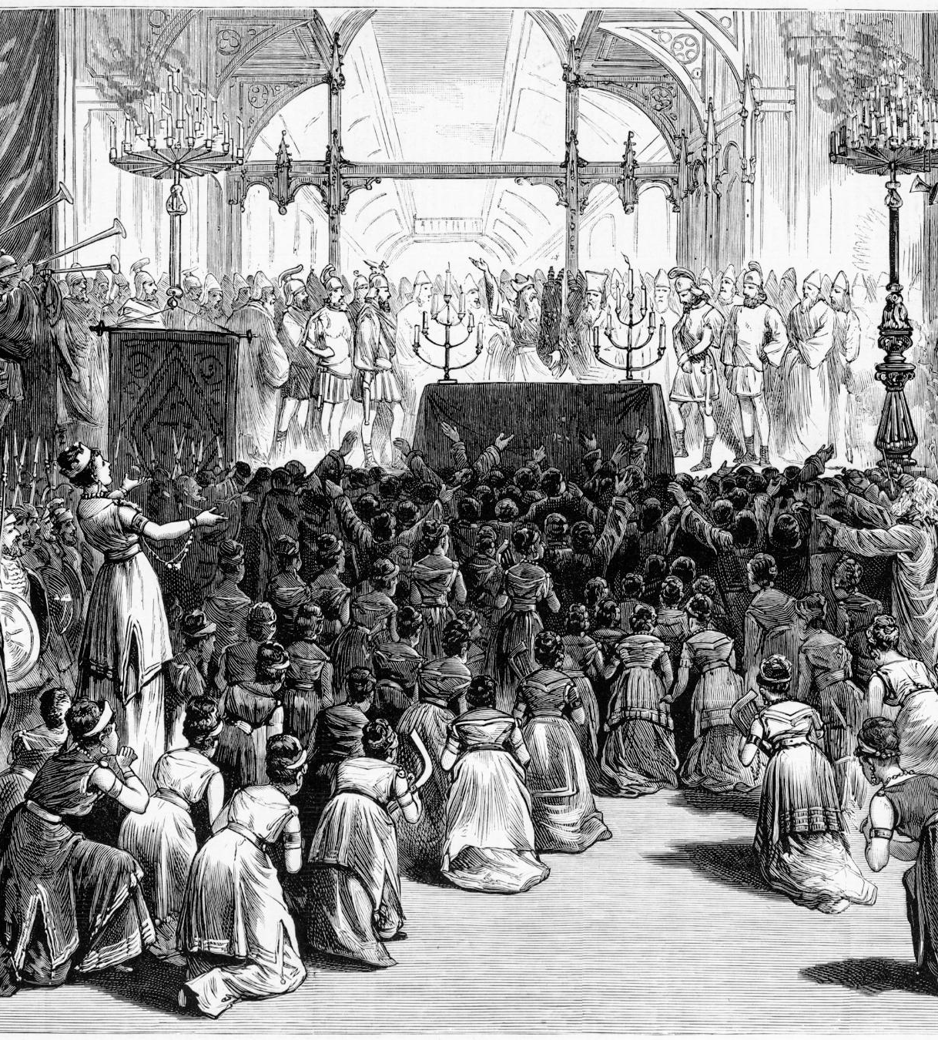
Reading of the Megillah
Public Reading Ritual
  The reading of the Megillah is a vital part of Purim celebrations, engaging the community in a shared experience.
Scroll of Esther
  The Megillah, or Scroll of Esther, recounts the story of Purim and the triumph over Haman's plot.
Expressing Disapproval
  During the reading, participants make noise whenever Haman's name is mentioned, showing their disapproval.
Notes:
A central observance of Purim is the public reading of the Megillah, the Scroll of Esther. This ritual is performed in synagogues and highlights key events in the Purim story, with participants expressing their disapproval of Haman by making noise whenever his name is mentioned.

Slide 23

Giving Gifts and Charity (Mishloach Manot and Matanot LaEvyonim)
Mishloach Manot
  Mishloach Manot are traditional gift baskets of food given to friends during Purim, promoting friendship and joy.
Matanot LaEvyonim
  Matanot LaEvyonim refers to the charity given to those in need on Purim, emphasizing generosity and community support.
Community Bonds
  The act of giving gifts and charity on Purim strengthens community ties and fosters a spirit of support.
Notes:
On Purim, it is customary to give gifts of food (Mishloach Manot) to friends and to give charity (Matanot LaEvyonim) to those in need, reinforcing community bonds and support for the less fortunate.

Slide 24
Festive Meals and Celebrations
Communal Gatherings
Purim celebrations emphasize coming together with family and friends, enhancing the spirit of unity and joy.
Rich Foods and Drinks
Traditional dishes and special drinks are integral to the Purim feast, making the celebration vibrant and memorable.
Celebratory Spirit
The joyous atmosphere during Purim fosters laughter, fun, and a sense of community among participants.
Notes:
Purim is marked by festive meals and celebrations, where families and friends gather to enjoy rich foods and drinks. This communal aspect fosters a spirit of unity and joy.

Slide 25
Symbolic Foods and Treats
Notes:
Food plays a key role in Purim celebrations, with certain treats holding special significance. These foods not only satisfy the palate but also embody the holiday's themes.

Slide 26
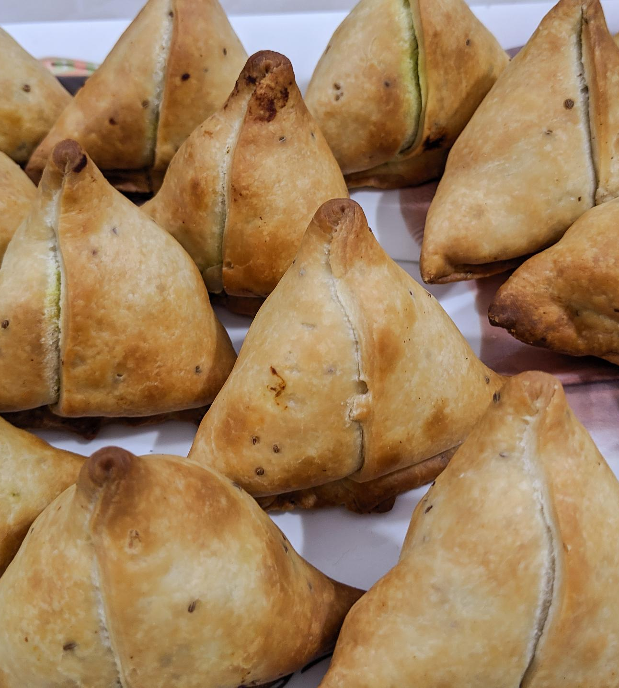
Hamantaschen: The Triangular Pastry
Symbolism of Hamantaschen
  Hamantaschen symbolize Haman's hat, representing the story of Purim and the triumph over evil.
Popular Fillings
  These pastries are commonly filled with poppy seeds, fruit preserves, or chocolate, catering to diverse tastes.
Purim Tradition
  Hamantaschen are a cherished treat during Purim, enjoyed at festive gatherings and celebrations.
Notes:
Hamantaschen are triangular pastries filled with sweet fillings like poppy seeds, fruit, or chocolate. They symbolize Haman's hat and are a beloved Purim treat enjoyed by many.

Slide 27

Feast and Special Meals
Purim Feast Tradition
  The Purim feast is a cherished tradition that brings families together to celebrate with joy and festivity.
Lavish Spread of Food
  A lavish spread of food and drink is a hallmark of the Purim feast, enhancing the celebratory atmosphere.
Merriment and Celebration
  The feast encourages merriment and celebration among families and friends, reinforcing community bonds and joy.
Notes:
The Purim feast is an important tradition, often featuring a lavish spread of food and drink, encouraging merriment and celebration among families and friends.

Slide 28
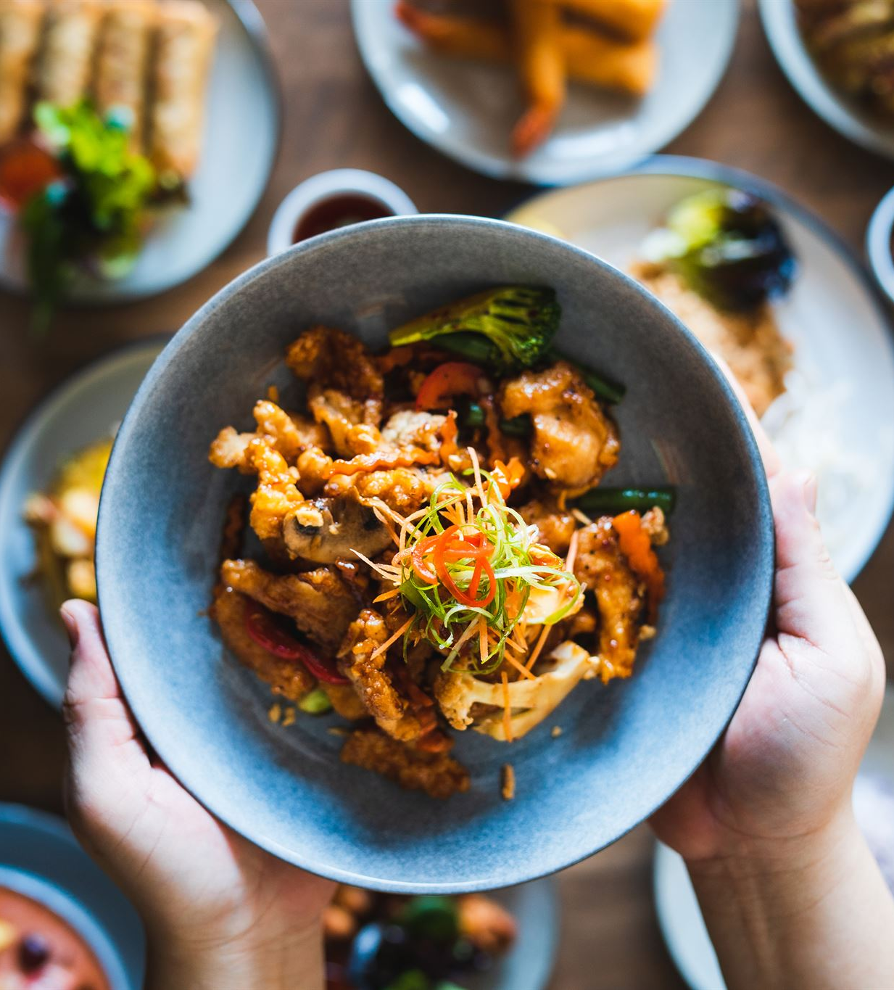
Other Traditional Foods
Cultural Significance
  Traditional foods vary across cultures, each having its own significance and history, enriching the culinary traditions of holidays.
Flavor Diversity
  The variety of traditional foods offers a rich diversity of flavors, enhancing the overall holiday culinary experience.
Culinary Traditions
  Traditional dishes help preserve culinary heritage, passed down through generations, reflecting the identity of different cultures.
Notes:
In addition to Hamantaschen, other traditional foods include dishes that are significant to specific cultures, adding a rich diversity of flavors to the holiday's culinary experience.

Slide 29
The Spirit of Joy and Festivity
Notes:
Purim is characterized by joy and festivity, encouraging participants to embrace a spirit of celebration, creativity, and community, making it one of the most joyful holidays in Jewish tradition.

Slide 30
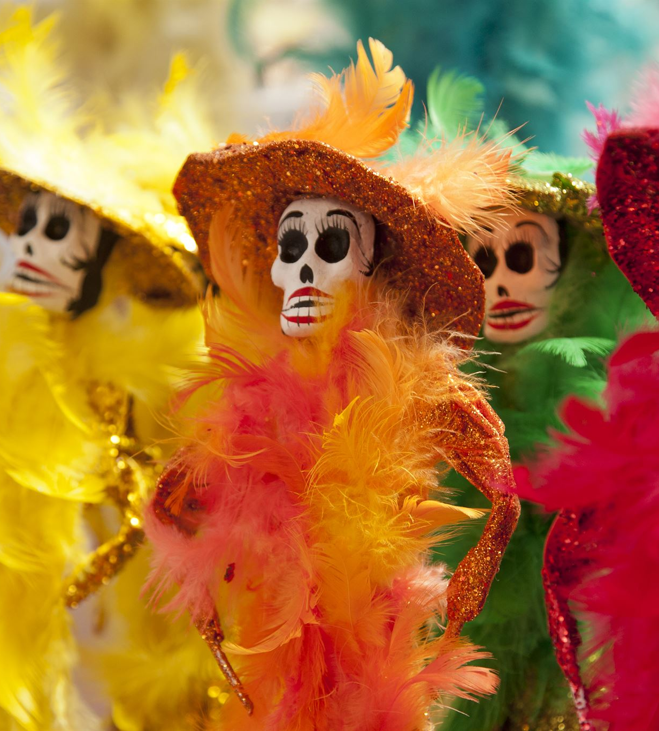
Costumes and Masquerades
Purim Celebrations
  Wearing costumes and masks during Purim creates a fun atmosphere and enhances the festive spirit of the holiday.
Themes of Transformation
  The custom of dressing up symbolizes the hidden identities and transformations that are central to the Purim story.
Notes:
Wearing costumes and masks is a Purim custom that adds an element of fun and festivity to the celebrations. This practice reflects the themes of hidden identities and transformations present in the Purim story.

Slide 31
Purim Spiels and Performances
Comedic Storytelling
Purim Spiels creatively retell the Purim story using humor to engage the audience and foster enjoyment.
Community Engagement
These performances not only entertain but also bring the community together, enhancing social bonds and collective joy.
Encouraging Creativity
Purim Spiels encourage artistic expression, allowing participants to explore their creativity through acting, writing, and directing.
Notes:
Purim Spiels are comedic plays that recount the Purim story in a humorous format. These performances engage the community and encourage creativity and artistic expression.

Slide 32
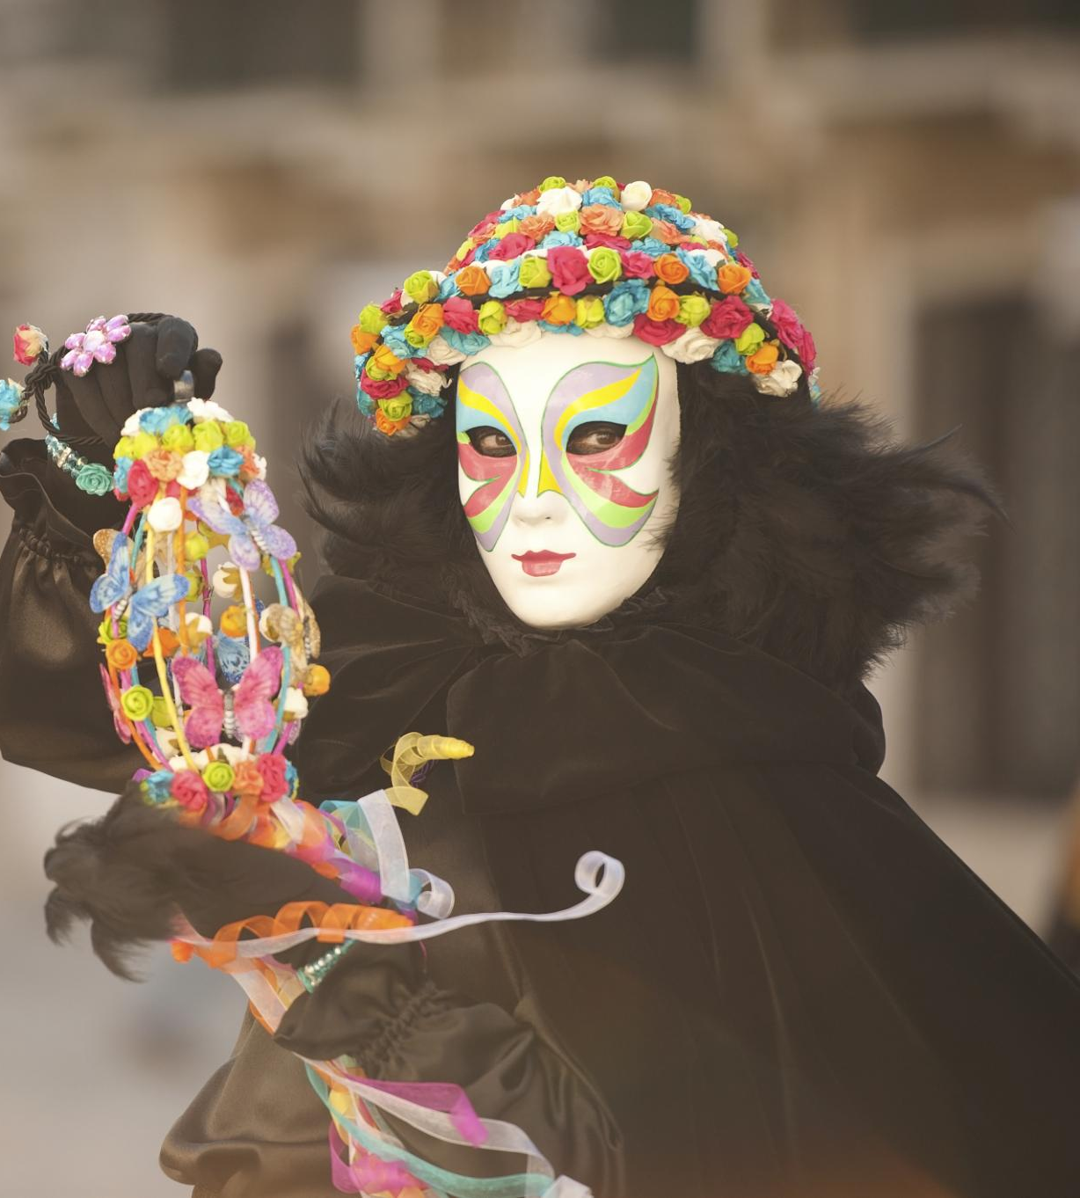
Music, Dancing, and Parades
Lively Music and Dance
  Music and dancing are central to Purim festivities, creating an atmosphere of joy and celebration among participants.
Community Gatherings
  Lively gatherings are a hallmark of Purim, uniting friends and family in celebration through music and dance.
Festive Parades
  Parades during Purim highlight the spirit of the holiday, showcasing costumes and performances that engage the community.
Notes:
Music and dancing are integral to Purim celebrations, with lively gatherings featuring joyous performances. Parades and community events bring people together to celebrate the holiday's spirit.

Slide 33
Purim Around the World
Notes:
Purim is celebrated in diverse ways across different cultures, reflecting local customs and traditions. This section will explore the global expressions of this festive holiday.

Slide 34

Different Cultural Expressions
Cultural Heritage
  Communities celebrate Purim with customs that highlight their unique cultural heritage and traditions.
Community Celebrations
  The variations in celebrations strengthen communal ties and foster a sense of belonging among participants.
Enriching Variations
  Different customs and practices enrich the overall celebration of Purim, showcasing cultural diversity.
© 2025 Georgia Chaplain Services LLC All rights reserved
Notes:
Different communities celebrate Purim with unique customs that reflect their cultural heritage. These variations enrich the holiday's celebration and strengthen communal ties.

Slide 35
Comparing Customs in Various Communities
Ashkenazi Purim Traditions
Ashkenazi customs for Purim include unique foods, costumes, and rituals that reflect their cultural heritage.
Sephardi Purim Customs
Sephardi traditions during Purim highlight different foods, songs, and community gatherings that showcase their rich culture.
Diversity in Practices
Exploring the variance in Purim customs reveals the rich diversity of practices within the Jewish diaspora.
Notes:
From Ashkenazi to Sephardi traditions, the customs surrounding Purim vary widely. Exploring these differences provides insight into the diverse practices within the Jewish diaspora.

Slide 36
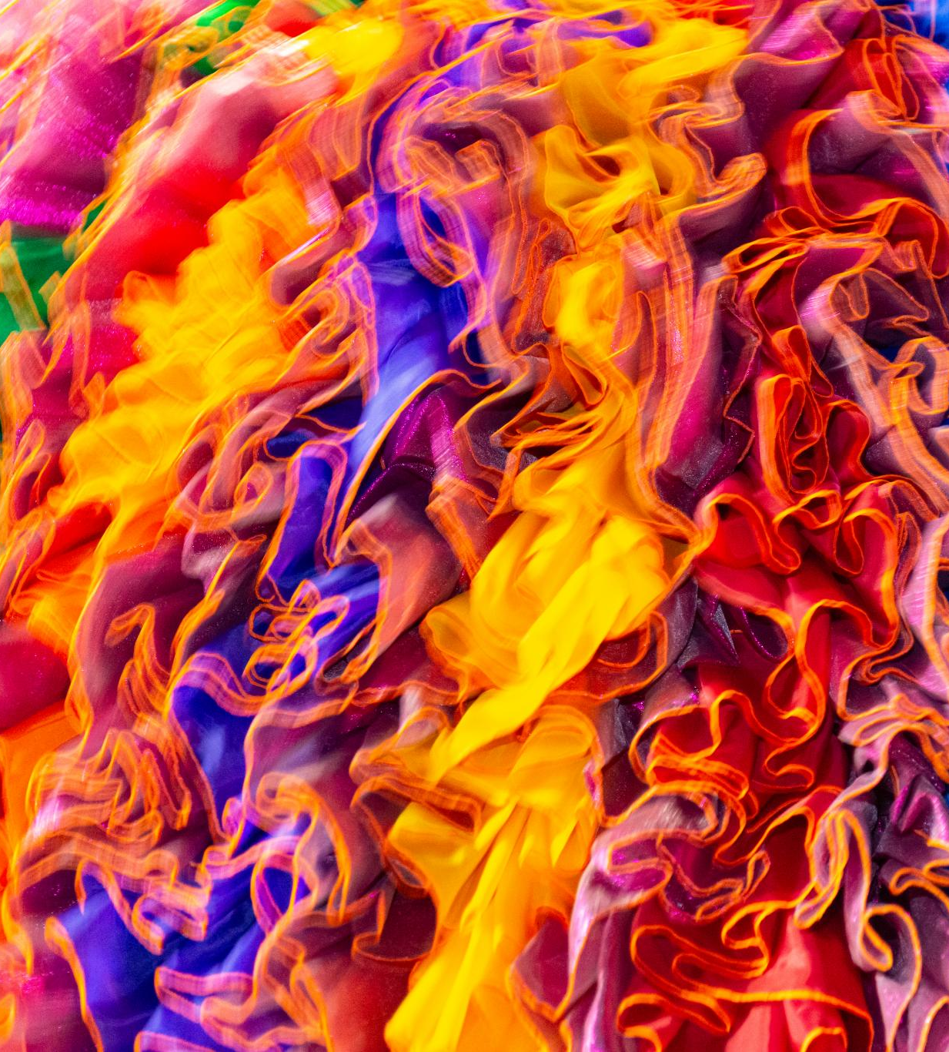
Purim in Modern Israel
National Holiday Celebration
  Purim is recognized as a national holiday in Israel, celebrating joy and unity among communities.
Public Events and Parades
  The holiday features vibrant public events and parades, showcasing the rich culture and traditions of Israel.
Community Celebrations
  Communities come together to celebrate Purim with joyous activities, including music, dancing, and sharing food.
Notes:
In modern Israel, Purim is a national holiday celebrated with great joy, featuring public events, parades, and community celebrations that reflect the vibrant culture of the country.

Slide 37
Conclusion
Historical Significance
  Purim celebrates the survival of the Jewish people, highlighting their resilience and strength throughout history.
Message of Hope
  The holiday conveys a powerful message of hope and perseverance, encouraging unity within the community.
Joyful Celebration
  Purim is marked by joy and festivity, bringing people together to celebrate through various customs and traditions.
© 2025 Georgia Chaplain Services LLC All rights reserved
Notes:
Purim is a holiday rich in history, tradition, and joy. It serves as a reminder of the strength of the Jewish community, the importance of delivering a message of hope, and the power of celebration. As we embrace the customs and spirit of Purim, we honor our heritage and share joy with others.

